Slide 1
SmartRepublic Project
A NEW SOCIAL APP
The GreenApp
Empowering communities to scale up!

Slide 2
Index
Breaking news…
Project Vision/Mission : The Mega- Shift!
A new approach: Regenerative Economics & networks
A new model: N2N & Network Interoperability and the SR platform: community strategic services
A global platform: Commercial Services, Financial, Operational Model
Benchmark of social networks (GAFA)
Agenda for a 4y Business Plan: 2019-2022
Conclusion

Slide 3
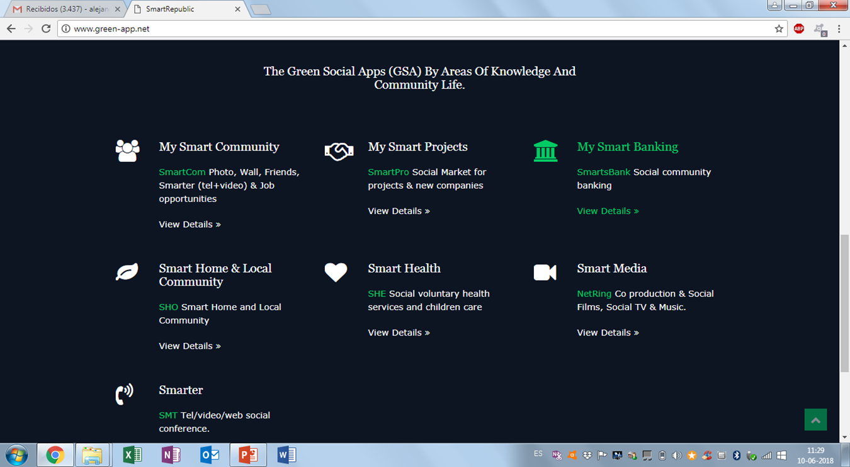
Breaking news
A new global knowledge platform
www.smart-republic.net
www.smartrepublic.uk

Slide 4
1.2 Vision 2030 / Mission
A Knowledge Sharing, Leadership, Empowerment & Social Financing Platform
One Goal:
The largest Global Online Platform for a Public Private Partnership Global Market Place for 3 billion people and 500 million homes to acces Green Energy; New Cooking ; Learning devices and Social Banking services.
An intelligent social /adaptive interface between global players and local actors. Where the bottom up and top down appraoches meet.
Why? The Ugly Global Social Facts
To cook food, nearly 3 billion people rely on open fires and simple stoves that burn solid fuels like wood, animal dung, charcoal, and coal. (500 M households)
Over 4 million* people die prematurely every year from illnesses attributable to household air pollution from cooking with solid fuels.
Up to 25% of black carbon emissions come from burning solid fuels for household energy needs.
Up to 34% of wood fuel harvested is unsustainable contributing to forest degradation, and climate change.
$123 billion in annual costs to health, environment, and economies in the developing world are due to the use of solid fuels for cooking.

Slide 5
1.3 Step mission implementation
A Knowledge Sharing, Leadership, Empowerment & Social Banking Platform through Interoperability Agreements (IOA-N2N)
How? A new online modular social model:
bottom-up community empowerment in 3 steps!
Step 1: Technology transfer: The global SR platform provides an adaptable cross-cultural Smart Social Model of 7 social services to communities (Smart Communities; Education & Empowerment; Financial Assistance; Social Media; Health assistance)
Step 2: Technical assistance: The global SR platform provides technical online and presential assistance and training to empower local community leaders to organise the community role in local/territorial Sustainable Master Plans or selected projects;
Step 3: Regeneration and governance at local level. The local communities organise themselves through a new type of e-governance and manage the services locally, within each country’s regulatory framework for sustainable development;

Slide 6
1.3 Mission in 3 steps: how it works…
A Knowledge Sharing, Leadership, Empowerment & Social Banking Platform and Interoperability Agreements N2N Fo
Step 1: Technology transfer: The global SR platform provides an adaptable cross-cultural Smart Social Model and IOA – N2N agreements
7 social services to communities
Smart Communities;
Education & Empowerment;
Financial Assistance;
Social Media;
Health assistance
Step 2: Technical assistance: to empower local community leaders
to organise the community role in local/territorial Sustainable Master Plans
to selected starting projects;
Step 3: Regeneration of economy and governance at local level.
The local communities organise themselves through a new type of e-governance
and manage the services locally, within each country’s regulatory framework for sustainable development;
To promote local e-governance

Slide 7
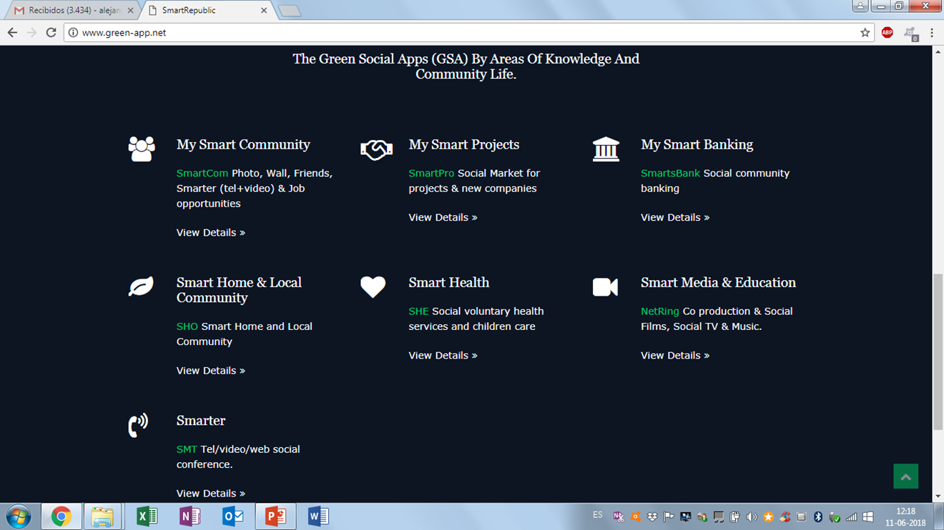
1.4 Smart Republic Platform
7 strategic areas of knowledge

Slide 8
2.1 A new approach:
Third Generation Social Model (3GSN)
Diagnosis: Social networks created in the past decade have seen explosive growth (first and second generation): search engines, mail services, chat spaces, forums, Google) and then from Facebook onwards (MySpace, YouTube, Twitter, Google+, etc)
But reached a limit and lost their ability to deliver more value and services to their customers
Especially because of limitations in allowing customers/users greater access to visibility in the networks and capturing services that promote them at a social and personal level:
Such as more sophisticated networking, knowledge-exchange dialogues, entrepreneurship, e-learning and creative development of talents for job search and social innovation.
This creates a dangerous social, transparency (regulatory) and financial threshold:
Social, because of the lack of credibility of many existing platforms (which concurred in social speculation despite what they had promised in the first place);
Financial, because it can lead to a new bubble in the stock and financial markets, that can burst and lead to high market volatility.
Therefore, some of the existing Giant Social Networks might prove unsustainable and undergo a crisis (The Social Paradox Phenomena: an empty window with millions of eyes with infinite social expectations)

Slide 9
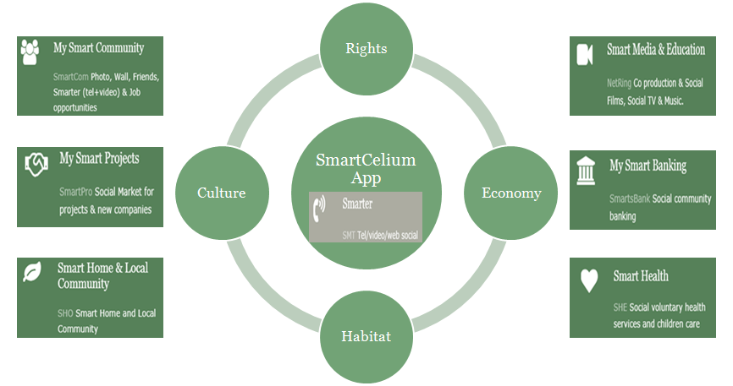
2.1 A new approach:
High Level SmartCelium App Design

Slide 10
Smart Republic Domain Rights:
New websites Registered for Green App, social services, soft-banking, brokering and networking:
www.Smart-Republic.net
www.Green-App.com
www.ppp-marketplace.com: home, social market for project introduction, sponsoring, market making, news and financing
www.socialsharespost.com: social financial network
www.socialpostnews.com: social news, forums and online TV
www.thesocial-marketplace.com: web-to-web; W2W social business (in development)
www.Green-App.net
www.Social-App.net
www.social-green-bank.com/net
www.social-book.net
www.social-bank.net

Slide 11
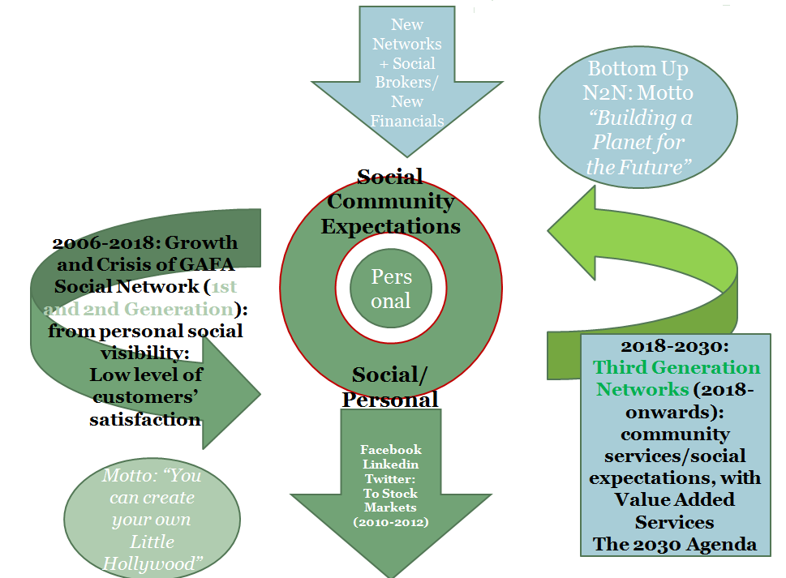
2.2. Regenerative Social Network Models (N2N)
The GAFA Social Networks Paradox
The less you truly offer
The more affiliates you get
Undermining transparency
& data security

Slide 12
3. 1. Scientific solution & New N2N interoperability model
Foundations: N2N Synaptic Model & Key concepts
Open platforms/Interoperability: Smart social networks
Social base of the pyramid oriented Synaptic Tree Model (STM) & Smart Republic platform:
Motto: “Communities Are Made of Individuals”
“Networks of networks are for individuals”

Slide 13
3.2. Scientific findings and Regenerative Economics
Summary/concepts
Concepts for the operational model:
Interoperability of social - N2N Network to network business - Defining new Social Brokers– (Social Agents for inter-operability): N2N - New Social financial Intermediation - Defining e-governance at local level
Modular e-Platforms - adaptable locally

Slide 14
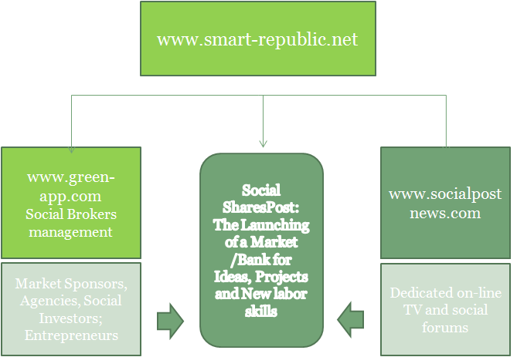
3 .3. The New Social Business Model: N2N franchising & Open Platforms
A Sustainable Model and Web network agreements & expansion

Slide 15
3.4. Regenerative eco/social benefits scale up
The communities define their e-Governance
The communities define their social preferences for the 7 strategic project axes
The communities instantly post their best projects in the PPP Marketplace
The social investors have access to a global and local repository of bankable projects presented by social-brokers
Leaders empower communities and communities empower leaders in the Marketplace
Communities create projects, projects create jobs, the market creates knowledge and training skills
Global added value + social justice

Slide 16
3.5 Smart Republic Canvas Model
Financial strategy; private capital raising and stock Exchange
Commercial contracts & franchising;
Company Legal model
Regulatory issues
Scientific governance;
Branding & Domain registration
Parnerships & Alliances

Slide 17
4. SR Commercial & Operational model: financial flows by service
- Revenues : Franchising Contracts, Advertising & service tarifs & revenues
- Advertising, Marketing & contributions from the industrial and banking sectors - Services for distribution of media products
- Social coaching for community leaders
- Local platform franchising: e-governance and N2N interoperability agreements - Services open to all citizens (free); no charge for citizens registered in the 7 axes platform - Services to Premium Clients - Market brokerage services for projets and businesses -Counseling Service for social banking networks

Slide 18
4. SR-GreenApp franchising working groups
FranchisingPilot Projects
2018/19
Ongoing negociations 2018:
Santiago, Chile
Rio do Janeiro, Brazil
Targeted 2018-2019:
India
South Korea
Lausanne, Switzerland
San Francisco, California
Paris, France
Sussex, UK
City of Singapore, Singapore

Slide 19
5. Benchmarking existing major networks
4 broad social network models:
USA Silicon Valley & GAFAs (IOA by default)
India (in development)
China (state regulated & monopoly)
New IOA Agreement Models (direct IOA)
French Model – (in development)/
Swiss Canton Model (in development)/
Estonia & Finland - free interoperability (ongoing)
Other, Alternative Open-source;

Slide 20
5.2 Benchmarking: Comparative GAFA indicators
The GAFAs: Customers/Registered Users
2.2 billion for Facebook
500 million for GMail
500 million for Twitter
301 million for Yahoo! Mail
200 million for LinkedIn
121 million for Amazon
60 million for Qwant

Slide 21
5.3 A Paradoxical Success Story: Facebook
From the traditional college Facebook to Facebook Innovation
The social charm: “We’re all friends”
The network’s exponential growth
The unknown financial story behind success:
Personal finance & credit cards
First modest private capital investment
The Sharespost Model (Sillicon Valey)
The Nasdaq
Data breach leading to political crisis
Facebook challenge to commercial banks
Demostrates that social networks are not ethically regulated
Result: competency & data privacy problems, poor social value

Slide 22
6.1 Key Events: International Agenda – 3&4 Q, 2018
Zoom Agenda SR : 6 months visibility
3-10 Sep : “11eme Edition Forum Convergences”, Palais Brongniart-Paris
28-30 Sep : “7eme Edition LHF Forum”, Le Havre
11 Oct : “Global Investment Forum”, Paris Europlace
PARIS INFRAWEEK 2018 Paris - October 8-12, 2018
Climate Financial Day, 26-28 November, 2018
3-14 Dec, “Conference Climatique Globale COP24-UNFCCC”, Katowice, Poland.
San Francisco Climate Forum, September 12-14, 2018
Internet Governance Forum (IGF), Paris, 12-14 Nov, 2018

Slide 23
6.2 Short term Planning : 2 Interconnected Agendas
3-10 Sep : “11eme Edition Forum Convergences”, Palais Brongniart-Paris
28-30 Sep : “7eme édition LHF Forum”, Le Havre
11 Oct : “Global Investment Forum”, Paris Europlace
PARIS INFRAWEEK 2018, Paris - October 8-12, 2018
Climate Financial Day, Paris, 26-28 November, 2018
3-14 Dec, “Conference Globale COP24-UNFCCC”, Katowice, Poland.
San Francisco Climate Forum, September 12-14, 2018
3/10 Sep : “11eme Edition Forum Convergences”, Palais Brongiart-Paris
28/30 Sep : “7eme édition LHF Forum”, Le Havre
11 Oct : “Global Investment Forum”, Paris Europlace
PARIS INFRAWEEK 2018
Paris - October 8th to 12th, 2018
Climate Financial Day, 26/28 Novembre, 2018
3/14 Dec, “Conference Globale COP24-UNFCCC”, Katowice. Pologne.
Business Plan presentation and project funding Road Show (September-November 2018)
Definition Participation Model in the Green App Company and partnerships (September-November 2018)
Jour D: official presentation / launch : 3 December 2018
Launch of Retroplanning, Paris, June 2018 and Pre-funding
Constitution Appli Team (France, July 2018- International Pilots, July-September 2018
Partnership and Expert Counsel Agreements, September-October 2018
Business Model Presentation, August 2018

Slide 24
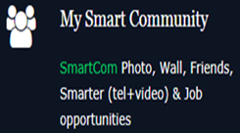
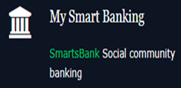
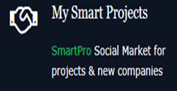
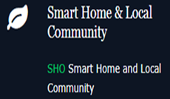
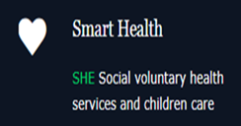
SmartRepublic
A Knowledge & Empowerment Platform
For the People & by the People
The GreenApp

